Slide 1
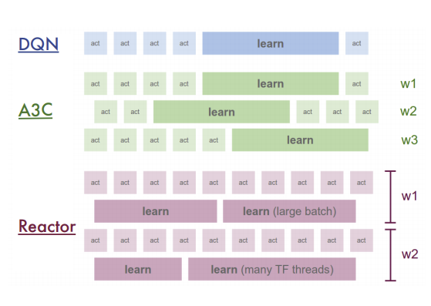
Executor (Act)
Memorizer
Learner
w1
ML8E-IS
Act
w2
Act
w3-8
Executor (Act)
Memorizer
Learner
w1
ML8E-IA
Act
Act
w2
Act
Act
Act
w3-8
Learner
w1
ML6E-OA
Memorizer
w2
Act
Act
Executor (Act)
w3-8

